Slide 1
Measuring Your Zero Trust Maturity
Elizabeth Schweinsberg
Digital Services Expert at CMS
Jeff Bond
Aquia Inc.

Slide 2



Who Are We?
[Presenter] Jeff Bond, Director of Security Architecture at Aquia
Supporting Centers for Medicare and Medicaid Services (CMS) on their Zero Trust journey.
Came from DoD contracting for 16-ish years doing all the security jobs from analyst to architect. Working Zero Trust for the last 3 years.
[Creator] Elizabeth Schweinsberg, Digital Services Expert at CMS

Slide 3
Agenda
What is Zero Trust?
Overview of the CISA Zero Trust Maturity Model
Applying Zero Trust to environments
CMS measured our Zero Trust maturity
Creating your own framework
Do the next best thing

Slide 4


What is Zero Trust??
It’s like trying to get to your seat at a professional sports game:
Bag check and metal detector
Ticket gets scanned
When you get to your section, ticket gets checked again
Some sections (e.g. club level) will have a 3rd ticket check
Notes:
Zero Trust is a security model that emphasizes frequently, or constantly, verifying trust relationships.
You move from checking permissions only at the perimeter to checking as one moves through a system.
Each user starts with Zero Trust. As you collect more information about a user moving through a system, you can choose to change the level of trust placed in that user.

Slide 5
Three Popular Zero Trust Frameworks
NIST SP 800-207 Zero Trust Architecture
7 Tenets, 3 architecture approaches
DOD Zero Trust Reference Architecture
7 Pillars with different functions and 3 maturity levels
CISA Zero Trust Maturity Model
5 Pillars with functions, 3 cross cutting functions, and 4 maturity levels
Notes:
CISA 4 maturity levels are new for v2. Before there were 3 levels.

Slide 6
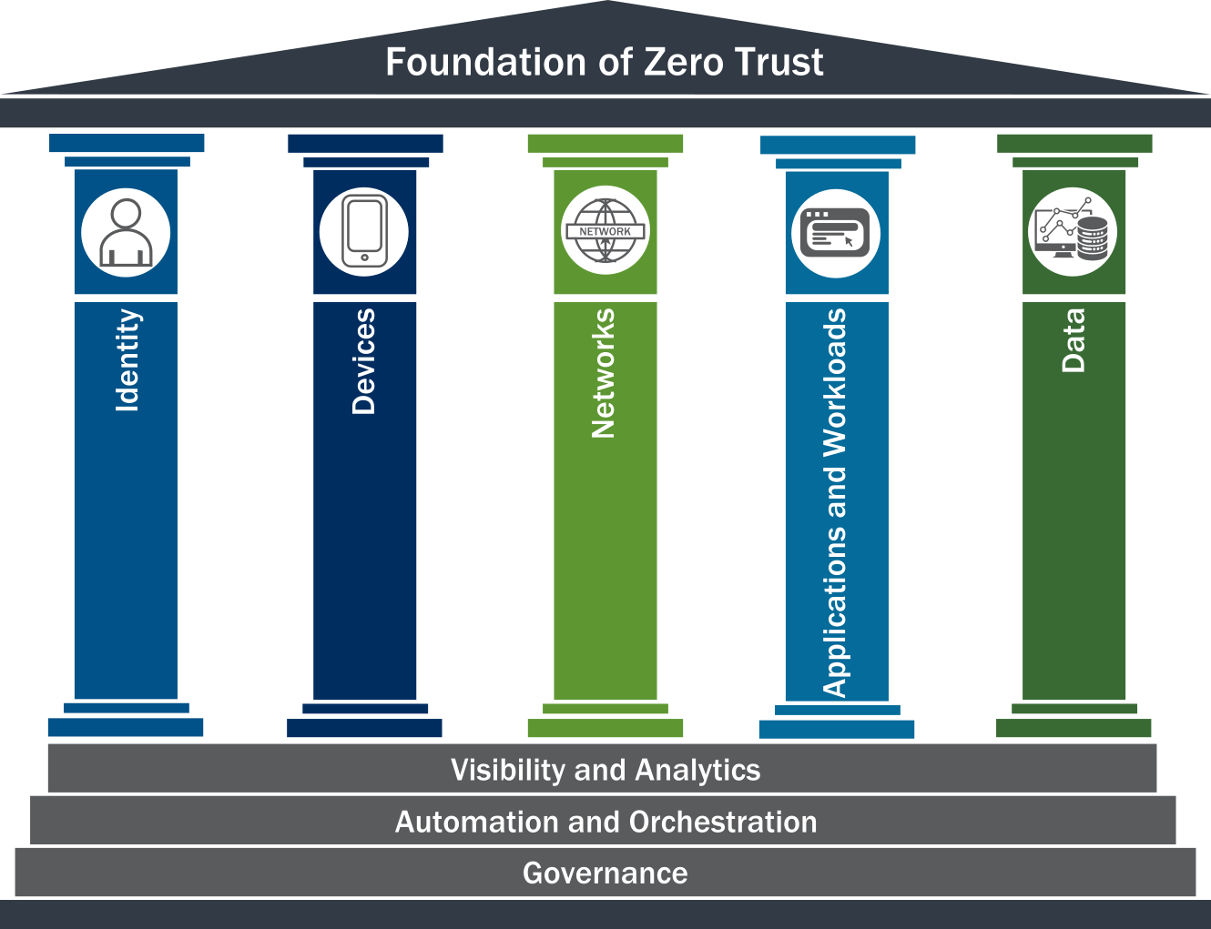
CISA Zero Trust Maturity Model
5 Pillars with functions
Identity
Devices
Networking
Applications and Workloads
Data
3 cross-cutting functions
Visibility and Analytics
Automation and Orchestration
Governance
4 levels of maturity
Traditional
Initial
Advanced
Optimal
Notes:
Explain functions via the Identity pillar
Authentication / Identity Stores
Authorization or associated permissions
Priv Management
Risk Assessment – How risky is an identity
Cross-Cutting functions and their applicability to all pillars

Slide 7
CISA Zero Trust Maturity Levels
Traditional | Initial | Advanced | Optimal
Manual configured Siloed pillars Set at provisioning Limited visibility | Starting to have automation Some cross-pillar integration Time-based changes Aggregated visibility | Automated wherever applicable Policy enforcement integrated across pillars Changes based on risk & posture assessments Centralized visibility | Fully automated, just-in-time Cross-pillar interoperability with continuous monitoring Dynamically set for enterprise-wide Centralized with situational awareness
Notes:
The CISA model is heavily built towards the “Agency” level but much of it is applicable to every layer of your organization.
Initial cross pillar integration, is things like device certificates so handling machine identity.
Advanced risk based changes, things like using your corporate laptop vs. a phone and what you can have access to.
~10min

Slide 8



Identity in Different Environments
Enterprise
On-Prem Data Center
IaaS
Staff and Contractors using business applications
System administrators and developers launching software AND users of our services
System administrators and developers launching software AND users of our services
Notes:
Zero Trust looks different in different environment types. Taking for example, Identity. Standard enterprise where you just have some internal software and corporate controlled laptops is simple and straight forward.

Slide 9

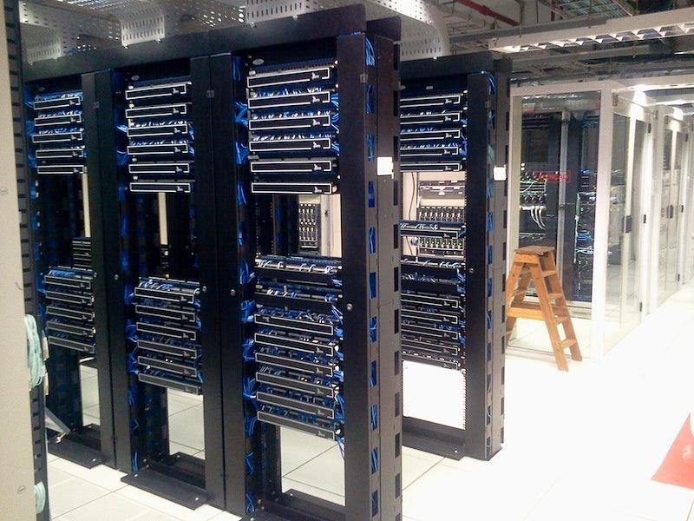
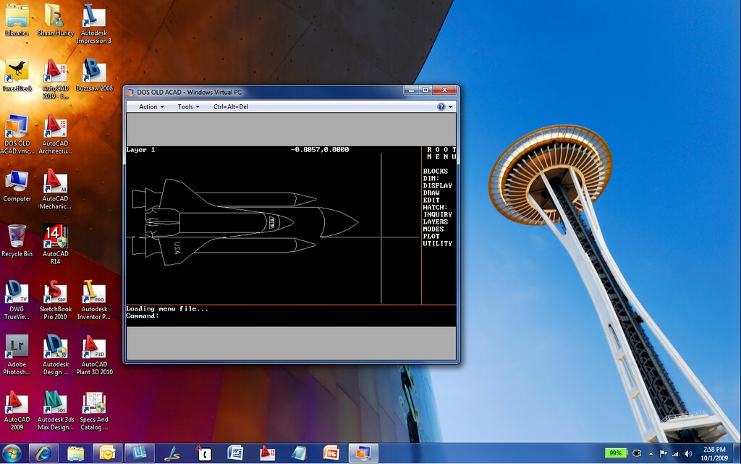

Devices in Different Environments
Enterprise
On-Prem Data Center
IaaS
Laptops and mobile phones
Servers in Racks
Virtual Machines and Containers
Notes:
Again, in an Enterprise handling devices is fairly straight forward. In an on prem data center though, there is SO much more work to do to manage the plethora of machines. Supply chain, device inventory, etc.
Cloud providers you won’t be dealing with the physical servers but those virtual machines and containers are now your “devices”.

Slide 10
Creating your own framework
Decide on which environment to evaluate
Change the maturity levels for each Pillar/function pair to match what you want your environment to have
Write questions that help you determine what level a system for the pillars and functions
Get teams to fill out the questionnaire
Grade the questionnaire
Give the teams feedback on their levels
Write up how to increase the maturity of the functions with the most room to improve
Notes:
~15 min

Slide 11
Creating an environment specific maturity model
How CMS got started
Notes:
We started with our most popular IaaS provider and tailored a maturity model to it, including specifics about our Organization.
This allowed us to keep some of our answer options limited since only what the cloud provider offers is available.
Unlike your own data centers, a cloud provider generally provides a llimited number of options for each service type.
That is where we got started, so lets dive into a couple examples of different pillars and functions.

Slide 12
CISA vs. IaaS: Identity
Model | Function | Traditional | Initial | Advanced | Optimal
CISA | Authentication | Agency authenticates identity using either passwords or multi-factor authentication (MFA) with static access for entity identity. | Agency authenticates identity using MFA, which may include passwords as one factor and requires validation of multiple entity attributes (e.g., locale or activity). | Agency begins to authenticate all identity using phishing-resistant MFA and attributes, including initial implementation of password-less MFA via FIDO2 or PIV. | Agency continuously validates identity with phishing-resistant MFA, not just when access is initially granted.
IaaS | Authentication - Developers | Team members authenticate with Username/Password, multi-factor authentication (MFA). Access does not take into account any additional attributes. | Team members authenticate MFA, which may include passwords as one factor. Also incorporates 1 additional attribute into access (e.g. SASE use or a device signal). | Team members authenticate via phishing-resistant MFA. Initial access accepts at least one device level or proofing signal for dynamic access control. | Team member's identity is continuously validated, not only for initial access but also throughout the lifecycle of the session; only uses phishing- resistant MFA. Uses dynamic, attribute-based access control.
Notes:
Don’t expect you to read ALL of this right now, we’ll dive in to each level.
One of the ways we tried to simplify Identity was to split portions of it into “Users” and “Developers”. These were major groups of user types that were generally similar but different from each other.
Levels are in explained in following slides

Slide 13
CISA vs. IaaS: Identity > Authentication > Traditional
Model | Function | Traditional
CISA | Authentication | Agency authenticates identity using either passwords or multi-factor authentication (MFA) with static access for entity identity.
IaaS | Authentication - Developers | Team members authenticate with Username/Password, multi-factor authentication (MFA). Access does not take into account any additional attributes.
Notes:
At this level, you may or may not have MFA but it could be available.

Slide 14
CISA vs. IaaS: Identity > Authentication > Initial
Model | Function | Initial
CISA | Authentication | Agency authenticates identity using MFA, which may include passwords as one factor and requires validation of multiple entity attributes (e.g., locale or activity).
IaaS | Authentication - Developers | Team members authenticate MFA, which may include passwords as one factor. Also incorporates 1 additional attribute into access (e.g. SASE use or a device signal).
Notes:
At this level we started to get a little more specific, MFA is available, but still optional. Here we also bring in another indicator for verification. For us, it was a device signal so that would be something like VPN use or Zscaler…. (Fancy VPN)

Slide 15
CISA vs. IaaS: Identity > Authentication > Advanced
Model | Function | Advanced
CISA | Authentication | Agency begins to authenticate all identity using phishing-resistant MFA and attributes, including initial implementation of password-less MFA via FIDO2 or PIV.
IaaS | Authentication - Developers | Team members authenticate via phishing-resistant MFA. Initial access accepts at least one device level or proofing signal for dynamic access control.
Notes:
As we move into advanced, the MFA options become stricter into phishing resistant MFA. This is also the beginning of integrating the access control into authentication.

Slide 16
CISA vs. IaaS: Identity > Authentication > Optimal
Model | Function | Optimal
CISA | Authentication | Agency continuously validates identity with phishing-resistant MFA, not just when access is initially granted.
IaaS | Authentication - Developers | Team member's identity is continuously validated, not only for initial access but also throughout the lifecycle of the session; only uses phishing-resistant MFA. Uses dynamic, attribute-based access control.
Notes:
At this Optimal level, authentication is now happening all the time, ideally this is also mostly invisible to the end user. The access control is also dynamic and able to change based on the risk level of the user.
~19min

Slide 17
CISA vs. IaaS: Devices
Model | Function | Traditional | Initial | Advanced | Optimal
CISA | Governance | Agency sets some policies for the lifecycle of their traditional and peripheral computing devices and relies on manual processes to maintain (e.g., update, patch, sanitize) these devices. | Agency sets and enforces policies for the procurement of new devices, the lifecycle of non-traditional computing devices and virtual assets, and for regularly conducting monitoring and scanning of devices. | Agency sets enterprise-wide policies for the lifecycle of devices and virtual assets, including their enumeration and accountability, with some automated enforcement mechanisms. | Agency automates policies for the lifecycle of all network-connected devices and virtual assets across the enterprise.
IaaS | Governance | Team has some lifecycle policies for the digital assets in their application. They rely on manual processes to maintain the devices. Gold Images may be used. | Team has a documented device lifecycle plan, which is implemented manually. Monitoring and scanning of devices is automated. Routine patching is done monthly. Gold Images are used where possible. | Device lifecycle plan is implemented both manually and automatically. Gold Images are used where possible. Routine patching is done at least every two weeks. System automates notifications for device policy deviations. | Device lifecycle plan is automated. Gold Images are used where possible. Routine patching is done at least every two weeks. Team employs auto-remediation for device non-compliance.
Notes:
Governance is one of the easiest ways to get started. It’s often less expensive than, for instance, buying and configuring an MFA system.
Speaking to virtualized enviros specifically
IaaS == Cloud provider

Slide 18
CISA vs. IaaS: Devices > Governance > Traditional
Model | Function | Traditional
CISA | Governance | Agency sets some policies for the lifecycle of their traditional and peripheral computing devices and relies on manual processes to maintain (e.g., update, patch, sanitize) these devices.
IaaS | Governance | Team has some lifecycle policies for the digital assets in their application. They rely on manual processes to maintain the devices. Gold Images may be used.

Slide 19
CISA vs. IaaS: Devices > Governance > Initial
Model | Function | Initial
CISA | Governance | Agency sets and enforces policies for the procurement of new devices, the lifecycle of non-traditional computing devices and virtual assets, and for regularly conducting monitoring and scanning of devices.
IaaS | Governance | Team has a documented device lifecycle plan, which is implemented manually. Monitoring and scanning of devices is automated. Routine patching is done monthly. Gold Images are used where possible.
Notes:
At Initial we started to actually set some expectations.
The Lifecycle plan needs to be actually written down… and hopefully accepted by the business.
Patching should be done at some kind of regular interval.
Gold images are lovely…. Some kind of secure source.

Slide 20
CISA vs. IaaS: Devices > Governance > Advanced
Model | Function | Advanced
CISA | Governance | Agency sets enterprise-wide policies for the lifecycle of devices and virtual assets, including their enumeration and accountability, with some automated enforcement mechanisms.
IaaS | Governance | Device lifecycle plan is implemented both manually and automatically. Gold Images are used where possible. Routine patching is done at least every two weeks. System automates notifications for device policy deviations.
Notes:
Patching happens a lot more frequently… 2 weeks…. At least on average. Some of it may even be done automatically.

Slide 21
CISA vs. IaaS: Devices > Governance > Optimal
Model | Function | Optimal
CISA | Governance | Agency automates policies for the lifecycle of all network-connected devices and virtual assets across the enterprise.
IaaS | Governance | Device lifecycle plan is automated. Gold Images are used where possible. Routine patching is done at least every two weeks. Team employs auto-remediation for device non-compliance.
Notes:
Auto-remediation is happening now! People don’t always have to be touching things.
For us, the patching schedule was still set at 2 weeks because of some of our operational requirements.

Slide 22
CISA vs. IaaS: Data
Model | Function | Traditional | Initial | Advanced | Optimal
CISA | Data Encryption | Agency encrypts minimal agency data at rest and in transit and relies on manual or ad hoc processes to manage and secure encryption keys. | Agency encrypts all data in transit and, where feasible, data at rest (e.g., mission critical data and data stored in external environments) and begins to formalize key management policies and secure encryption keys | Agency encrypts all data at rest and in transit across the enterprise to the maximum extent possible, begins to incorporate cryptographic agility, and protects encryption keys (i.e., secrets are not hard coded and are rotated on a regular basis). | Agency encrypts data in use where appropriate, enforces least privilege principles for secure key management enterprise-wide, and applies encryption using up-to-date standards and cryptographic agility to the extent possible.
IaaS | Data Encryption | Team only encrypts some data stores at rest or in transit. Team relies on manual or ad hoc processes to manage and secure encryption keys. | Team encrypts all data at rest and all data in transit outside of the IaaS account. Team has begun to formalize key management policies and secure encryption keys. | Team encrypts all data at rest and in transit (both within and outside of the IaaS account) to the maximum extent possible. Team incorporates cryptographic agility into their processes and protects encryption keys. | Team encrypted data in use where appropriate. Team enforces least privilege for key management, and applies encryption using up-to-date standards and cryptographic agility to the extent possible.
Notes:
Lastly we’ll take a quick look at the Data pillar and specifically the Encryption function.
~20min

Slide 23
CISA vs. IaaS: Data > Encryption > Traditional
Model | Function | Traditional
CISA | Data Encryption | Agency encrypts minimal agency data at rest and in transit and relies on manual or ad hoc processes to manage and secure encryption keys.
IaaS | Data Encryption | Team only encrypts some data stores at rest or in transit. Team relies on manual or ad hoc processes to manage and secure encryption keys.
Notes:
You only encrypt some of your data.
Teams are handling their keys a bit willy nilly.

Slide 24
CISA vs. IaaS: Data > Encryption > Initial
Model | Function | Initial
CISA | Data Encryption | Agency encrypts all data in transit and, where feasible, data at rest (e.g., mission critical data and data stored in external environments) and begins to formalize key management policies and secure encryption keys
IaaS | Data Encryption | Team encrypts all data at rest and all data in transit outside of the IaaS account. Team has begun to formalize key management policies and secure encryption keys.
Notes:
All data moving around is encrypted and occasionally when it’s just sitting around.
Key management is under at least a bit of control. Those cloud service providers really make that a lot easier.

Slide 25
CISA vs. IaaS: Data > Encryption > Advanced
Model | Function | Advanced
CISA | Data Encryption | Agency encrypts all data at rest and in transit across the enterprise to the maximum extent possible, begins to incorporate cryptographic agility, and protects encryption keys (i.e., secrets are not hard coded and are rotated on a regular basis).
IaaS | Data Encryption | Team encrypts all data at rest and in transit (both within and outside of the IaaS account) to the maximum extent possible. Team incorporates cryptographic agility into their processes and protects encryption keys.
Notes:
All the data is encrypted almost all the time if it’s just hanging out or if it’s moving around.
More importantly there are like, real, policies about your key management and cryptographic handling.

Slide 26
CISA vs. IaaS: Data > Encryption > Optimal
Model | Function | Optimal
CISA | Data Encryption | Agency encrypts data in use where appropriate, enforces least privilege principles for secure key management enterprise-wide, and applies encryption using up-to-date standards and cryptographic agility to the extent possible.
IaaS | Data Encryption | Team encrypted data in use where appropriate. Team enforces least privilege for key management, and applies encryption using up-to-date standards and cryptographic agility to the extent possible.
Notes:
At that optimal level encryption actually gets wild and being applied to data while it’s being processed. That is tough though and still really in it’s early stages.
~25min

Slide 27
Collecting data at scale
Survey questions for fun and profit
Notes:
So we’ve got an idea of what maturity looks like… How do we find out what reality looks like?
We started with discussions directly with enthusiastic teams… This lead to multiple hour conversations and although intersting, wouldn’t work across the agency.
We also found that if teams knew a bit /too/ much about the maturity levels they’d tried to game the answers… *cough* GRC
Lastly, calling it a survey made it seem like some kind of fun and optional buzzfeed quiz…. In the government “data-call” commands respect.

Slide 28
Creating Questions: Identity
Authentication
Q. Which Multifactor Authentication methods are available?
Email
SMS
OTP or Push from authenticator app (Google Authenticator or DUO)
OTP from a hardware token
PIV/certificate
FIDO2/WebAuthn
None
Authentication
Q. Is Multifactor Authentication required?
Yes
No
Notes:
We created a LOT of questions at first,… about 160. No one is going to answer all those. So we limited it those that /really/ mattered.
Our questions were intentionally not open ended, to make it easier to grade. They also occasionally hid the “maturity” being measured.
Some of these authentications are replay resistant, those are what get you closer towards that coveted “Optimal”

Slide 29
Creating Questions: Devices
Device Governance
Q. Do you have a documented device lifecycle plan?
Yes
No
Device Governance
Q. At what frequency are patches deployed?
Automatically when a patch is released
Weekly
Every 2 Weeks
Monthly
Longer
Notes:
Does your plan even exist?
Patching cycles? Are you doing the minimum as defined by greater agency or has effort been applied to being in front of things?
~28min

Slide 30
Creating advice on how to improve Zero Trust maturity
Notes:
Application teams really /do/ want to be better. Sometimes they just aren’t exactly sure how. We certainly don’t expect them all to be Zero Trust experts.
But how could we provide results in a way that is comprehensive, but easy to understand and apply?....

Slide 31
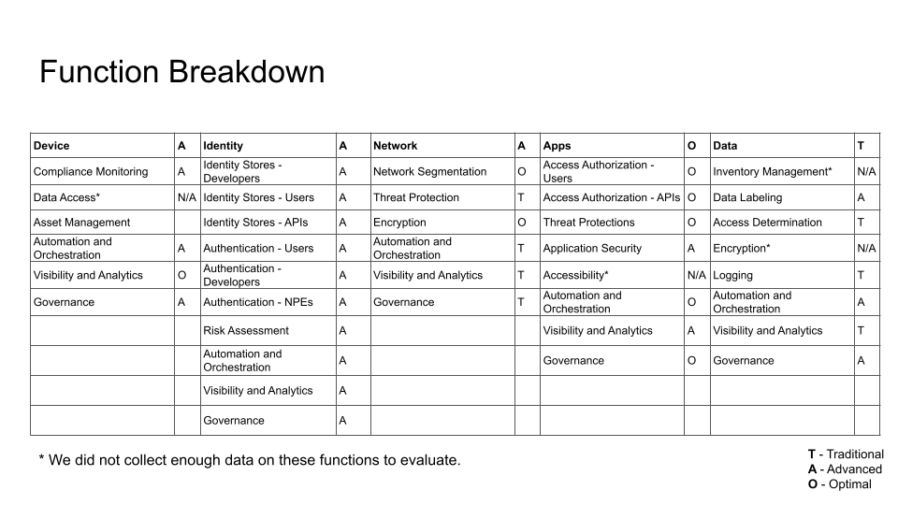
Screenshot
Notes:
People love nice charts.
This example is from CISA maturity model v1… but it gets the idea across.
Each function gets a score. There were a few that we didn’t ask about and that is on us. Part of that is just based on what they could control vs what was given to them.

Slide 32
Find the highs and lows
Which functions have the most room for improvement?
What is the lowest average score(s)?
Which functions have the least room for improvement?
What is the highest average score(s)?
Which functions can teams improve themselves?
Which functions need to be improved by the team running the IaaS organization?
Notes:
Turning this scoring to actionable things for you to do starts with some basic data analysis.
What areas is your org least mature? These are likely going to be those kinds of core infrastructure areas where one group controls the function and others just consume it.
What areas is your org strong in? Maybe you’ve got great device inventory and control. It’s obviously going to be better to focus on another area. In the mean time, you can sell team accomplishments to your leadership.
Deviations in functions between groups. Are some things being overlooked or was the question misunderstood?
Functions that were low and in control of the teams – here is some advice…. Maybe write down those word of mouth policies.
Functions from IaaS team would be much longer and more expensive projects. Maybe we could force the change maybe it would take a few years of nagging…

Slide 33
Find the areas that are the most different
High variance implies there is not enough guidance in an area.
Low variance implies there is probably a strong standard for a function.
Which functions have the most variance (e.g. high standard deviation)?
Which functions have the least variance (e.g. low standard deviation)?
Note: I am not a data scientist, but I spreadsheet well.
Notes:
High variance – Things we should likely be doing at the “agency” level. Teams are unsure of what they’re supposed to be doing.
Least variance – Identity stores and Authentication for Devs….
We’re using a 3rd party system for authentication brokers. It’s fairly standardized. In the data call we could just ask which one they’re using. We already knew it’s capabilities so we could just fill that in. We left an “Other” answer in so we could find out about the outliers specifically. Maybe it was justified.
~32min

Slide 34
Measuring your own Zero Trust maturity
Pick an environment.
Draft a team to write the model.
Run the bases and score a home run!
Create Questions
Tailor the Model
Ask the Questions
Pick an env.
Generate Scores
Notes:
Quick and easy home run, right?

Slide 35
Creating your own framework
Decide on which environment to evaluate
Change the maturity levels for each Pillar/function pair to match what you want your environment to have
Write questions that help you determine what level a system for the pillars and functions
Get teams to fill out the questionnaire
Grade the questionnaire
Give the teams feedback on their levels
Write up how to increase the maturity of the functions with the most room to improve
Notes:
Okay, again, here are the 7 steps which might make talking about this easier with your business.
One of the great things about maturity models is that they’re usually pretty general.
One of the terrible things about maturity models is that they’re usually pretty general.
Creating your own is a great way to move forward effectively.

Slide 36
Some parts of Zero Trust take a long time
Moving to passwordless authentication
Deploying CDM and EDR on every device
Fully micro-segmenting your network
Adding real-time risk analytics to application access authorization
Completely automated data inventory and tagging
But somethings you can do now with what you have
Notes:
Zero Trust is a GIAGANTIC concept that is still not widely or completely understood generally. When you look at your own results or just start your journey, It’ll look insurmountable.
It is absolutely true that some of the implementation projects are a beast of an undertaking.
Passwordless authentication… it’s awesome…. But it can take YEARS and likely needs buy in and money from leadership.

Slide 37
Incremental progress builds momentum
What is one improvement in each pillar?
Enable additional MFA options, maybe turn some off
Make sure everyone has a device lifecycle plan, and an explicit patching cadence
Add encryption to data in transit in your IaaS accounts
Standardize expectations for static application security testing
Add encryption to data at rest in your IaaS accounts
Notes:
Those small wins can really get the ball rolling… and not in a Sisyphean way.
These were the “quick win” maturity increases we determined would help the agency, but also help each individual team.
Some of these things can be just set at the highest level and enforced invisibly down the line. Even better, these things can be monitored real easy across large numbers of groups.
The encryption particularly is effective because it’s not just protection against attacks, but protection against mistakes…. Things may be a bit different now but all those unencrypted and exposed s3 buckets made a mess.

Slide 38
Elizabeth Schweinsberg
elizabeth.schweinsberg@cms.hhs.gov
@bethlogic on Twitter
https://github.com/eschwein-usds/decks
Jeff Bond
Jeff.Bond@aquia.us

